Slide 1
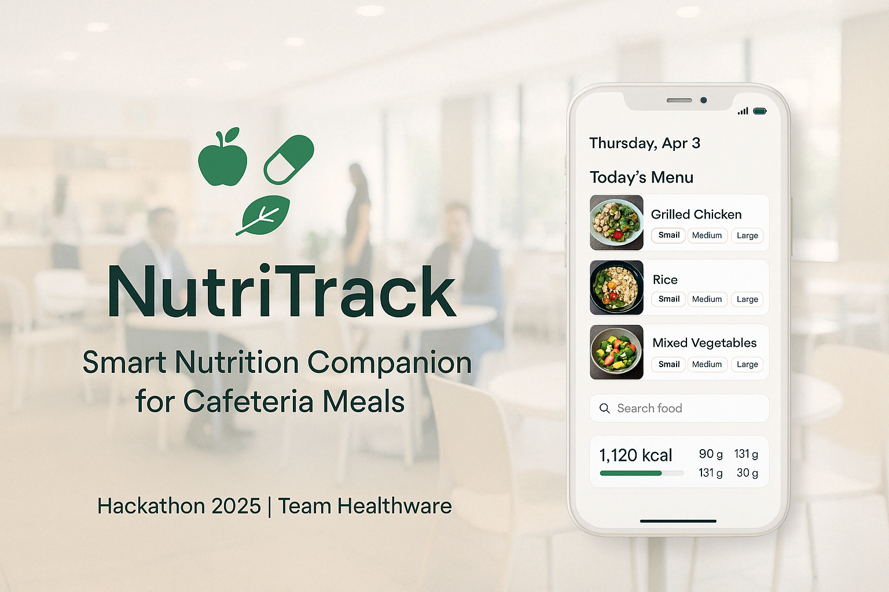
SmartCafé: Your Nutritional Companion
Hackathon Submission | April 2025
Smart Eating at Work: A mobile-first approach to empower office employees with nutritional insights from cafeteria meals.
Built for Intuition: Simple, multilingual UI designed for fast, on-the-go use in busy work environments.
Hackathon Ready: Polished prototype, scalable backend, and future-ready AI features.
Notes:
Welcome to SmartCafé, your intelligent nutrition companion for workplace wellness. In today's fast-paced office environments, grabbing a quick bite often comes at the cost of nutritional awareness. SmartCafé bridges that gap.
This project is our hackathon submission for April 2025, designed as a mobile-first platform that gives users personalized insight into their meal choices. With a seamless UI, a smart multilingual food database, and AI-enabled future features, we're not just tracking calories—we're changing habits.
Let’s take a look at how we’re reshaping cafeteria dining through tech, starting with the core problem we aim to solve.

Slide 2
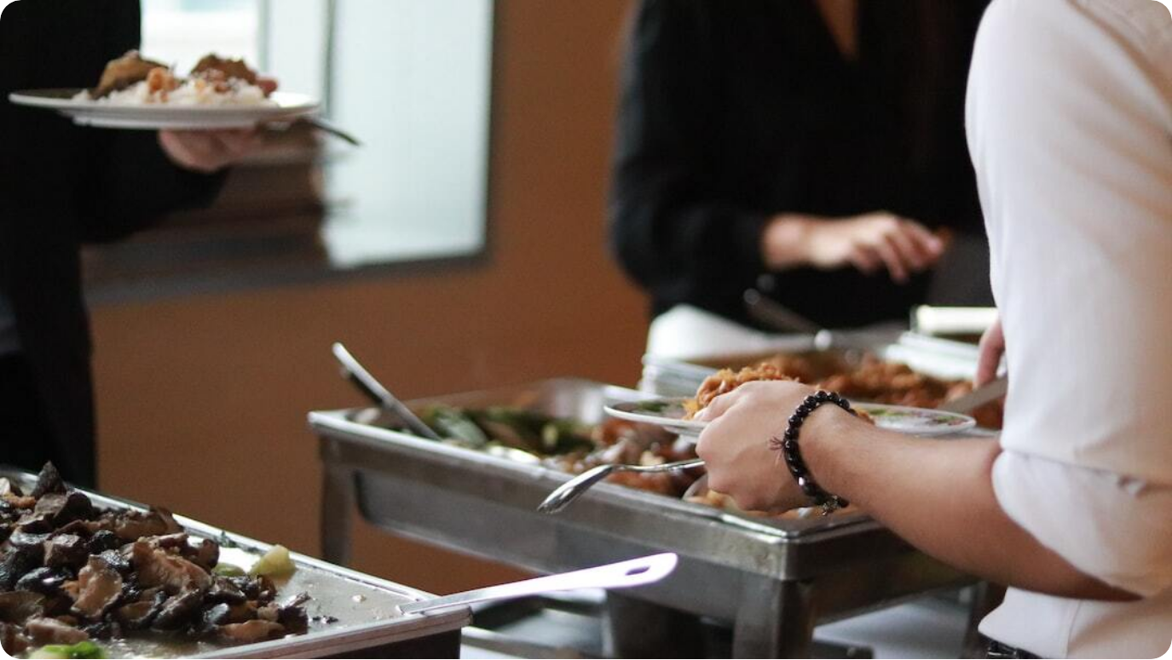
Problem Statement
Lack of Nutritional Awareness: Employees are unaware of calorie and nutrient content in cafeteria meals, affecting long-term health.
Limited Customization: Fixed meal sizes and rigid options restrict dietary flexibility and user control.
Multilingual Challenges: Language barriers make it hard to recognize or log culturally diverse dish names.
Photo by Joyce Toh on Unsplash
Notes:
Let’s address the problem SmartCafé is solving. In many workplace cafeterias, food choices are made blindly. Employees often don’t know the nutritional value of what they're eating. It’s not just about calories—it's about informed choices.
Cafeteria menus typically don’t offer nutrient insights, and there's little room for meal customization. Plus, when employees from diverse cultural backgrounds see names like 'Sundal' or 'Chitranna', understanding what it means or how it fits their diet becomes a challenge.
SmartCafé aims to solve all of this through intuitive tracking, flexible meal inputs, and multilingual food recognition.

Slide 3



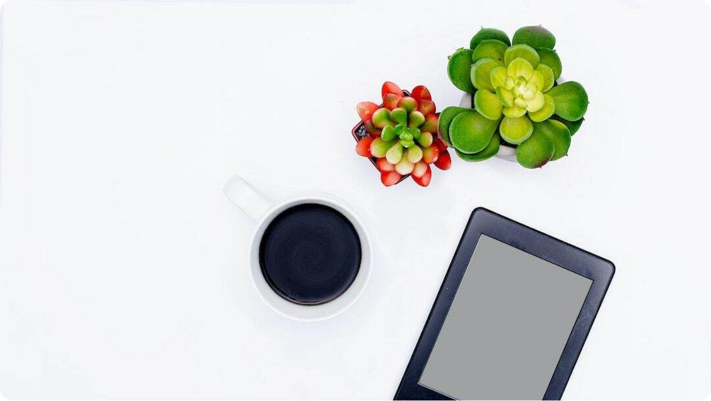
Vision & Objectives
Empowered Decision-Making
Equip users with real-time nutrition data to make better food choices.
User-Centric App Design
Build an intuitive, multilingual interface that supports quick meal logging.
Comprehensive Tracking
Log both cafeteria and external meals with AI-powered tools and comparisons.
Notes:
SmartCafé is built on a clear and compelling vision: to help people make smarter dietary decisions—especially in the workplace where options can be limited or poorly understood.
We want to empower users with accessible, real-time nutrition data, and this starts with a friendly app that works across languages and cultures. Users should be able to log cafeteria meals, add external foods, and see where they stand compared to global and workplace dietary averages.
Whether you're aiming for balanced meals or exploring healthier habits, SmartCafé gives you the insight and tools to take control of your daily nutrition.

Slide 4

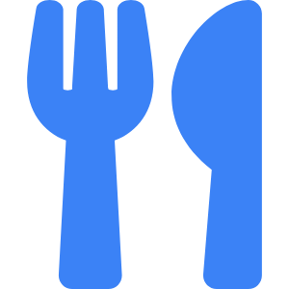

Mockup UI Screens
Visual Concept of Key App Interfaces
Home Dashboard
Displays daily nutrient summary, meal breakdowns, and trend visuals.
Portion Picker Menu
Click-based portion selector for cafeteria items (small, medium, large).
Custom Entry Flow
Easily log non-menu meals via search, image upload
Search should suggest the most relevant dish name
Notes:
Let’s dive into what SmartCafé actually looks like in action. These mockup UI screens showcase the thoughtful design and simplicity of the user interface.
From the home dashboard, users get a clear overview of their daily nutrient intake, including trend charts and comparative stats. The cafeteria menu interface offers a tap-based portion picker, making it fast and intuitive to record meals.
And for foods outside the menu? Just search the item, scan a barcode, or upload a photo—SmartCafé handles the rest. These visuals give a glimpse into how smooth the experience will be.

Slide 5
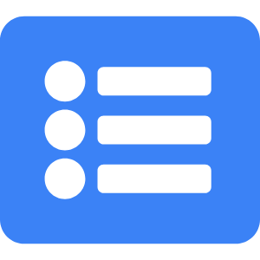

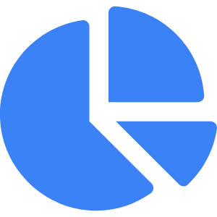
Frontend: Features in Detail
Cafeteria Menu Interface
Interactive UI with portion size picker and dish info.
Smart Meal Logging
Support for multilingual search, barcode scanning, and custom entries.
Visual Insights
Daily dashboard with graphs and percentile comparisons.
Notes:
The frontend of SmartCafé is designed for speed, clarity, and convenience. The cafeteria menu interface allows users to pick portions with a tap, quickly logging meals without navigating multiple screens.
It’s also smart—multilingual search adapts to cultural food terms, and users can log meals via barcode or even AI image input. Every entry is stored and visualized, giving users feedback on how their daily intake compares with healthy benchmarks.
We prioritized a light design theme and intuitive layout so users can act quickly and make informed decisions every time they eat.

Slide 6
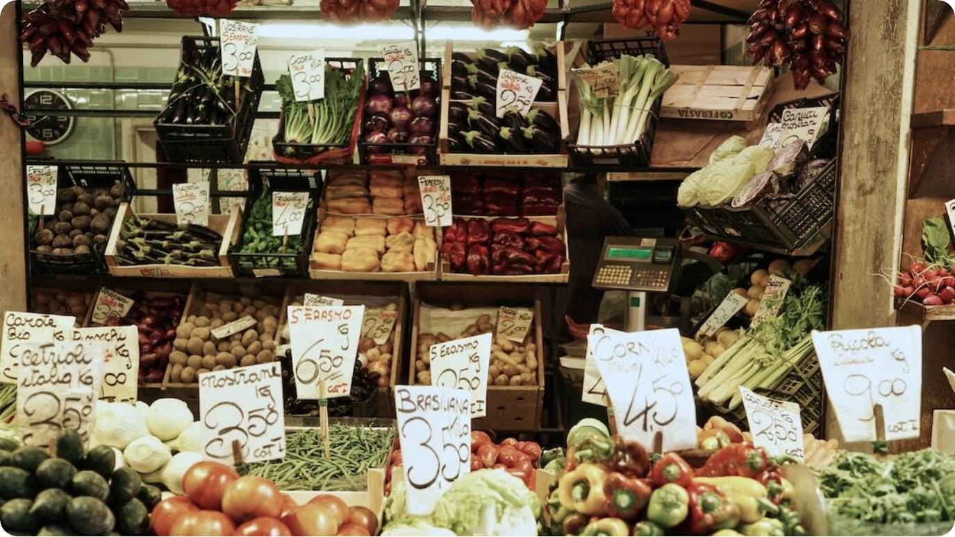
Smart & Multilingual Database
Localized Food Entries: Database includes region-specific names like 'Sundal' or 'Chitranna'.
Support to local languages: Users should be able to search for dishes in English, Hindi, Kannada, Tamil, Telugu, Marathi
Compact & Offline-Ready: Efficient storage ensures fast, reliable access even without internet.
Crowdsourced Updates: Canteen managers and users can contribute, with moderation and versioning.
Photo by Nikos Kavvadas on Unsplash
Notes:
Behind the frontend lies a powerful database that fuels SmartCafé’s multilingual intelligence. Every food entry is tagged with localized names, helping users recognize culturally relevant dishes instantly—think of 'Sundal' in India or 'Gado-Gado' in Indonesia.
This database is optimized for offline use, ensuring that users in remote office settings don’t face lags or loss of function. And because food is dynamic, the database is crowd-expandable—users and canteen staff can propose new entries, which are then moderated and version-controlled.
This collaborative model ensures the app stays relevant, useful, and culturally inclusive across office locations.

Slide 7
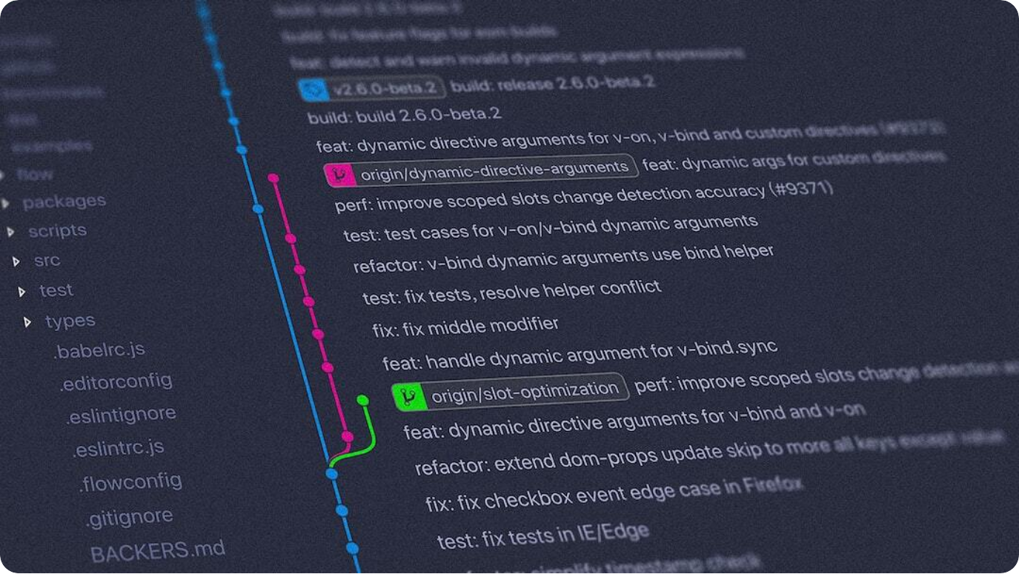
Backend Architecture & Data Handling
Hybrid Data Storage: Local DB embedded in app; central server optional for sync and analysis.
AI-Ready Design: Built to scale from manual entry to image-based food recognition.
Privacy-Respectful Analytics: User-consented data upload enables personalized advice and benchmarking.
Photo by Yancy Min on Unsplash
Notes:
SmartCafé’s backend architecture is designed with adaptability and scale in mind. At its core is a local database packaged within the app, ensuring fast access and offline usability. For broader analytics, syncing with a central server is available—but entirely optional.
The system is AI-ready, capable of growing from simple manual logs to sophisticated features like AI-powered food recognition. Every data stream is structured to support evolution without disruption.
User privacy is a cornerstone. Any analytics or trend uploads are consent-based. This foundation allows for features like personalized nutrition advice and percentile-based comparisons while maintaining data integrity and trust.

Slide 8
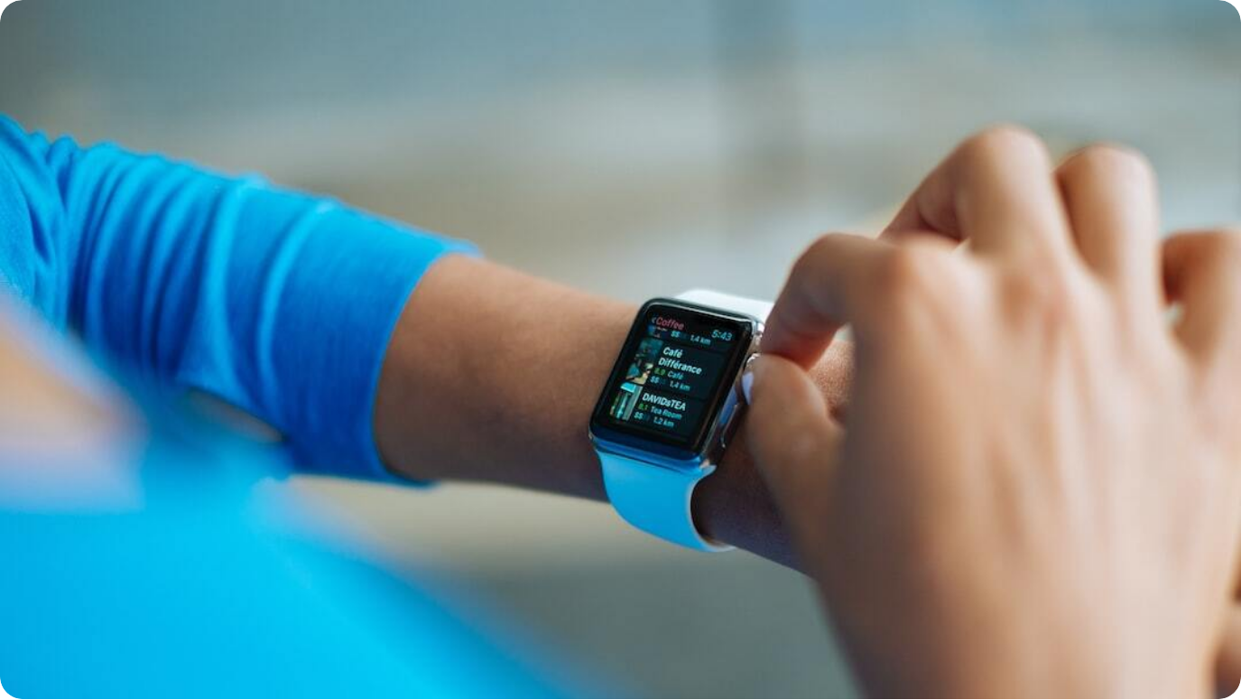
Future Enhancements
AI Food Recognition: Upload meal photo to detect items and estimate portion sizes.
Personalized Advice: Diet suggestions based on trends and deficiencies in intake.
Gamified Engagement: Badges, rewards, and daily goals to motivate healthy eating.
Photo by Luke Chesser on Unsplash
Notes:
Looking forward, SmartCafé is engineered for continuous innovation. One major upcoming feature is AI-driven food recognition. Just snap a picture of your meal, and the app will identify items and estimate serving sizes—ideal for busy users.
The app will also offer personalized dietary advice by analyzing trends in your intake and comparing them to health benchmarks. This turns data into real, actionable insights.
To keep users engaged and motivated, SmartCafé will gamify nutrition—think achievements, daily streaks, and progress rewards. Together, these enhancements create a more intelligent and empowering user experience.

Slide 9
Hackathon Timeline with Gates
Must-Haves (60 Points)
Criteria | Description | Points
Functional App & UI | Fully working app with intuitive and fast interface | 15
User Profile | Basic health info like height, weight, age and suggest individual dietary requirement | 5
Robust Food Database | Multilingual (at least English), rich, and expandable | 10
Custom Dish Support | Ability to search for and add off-menu/custom dishes | 5
Nutrition History | Displays past consumption trends and consumptions vs ideal requirement | 10
User Testing & Feedback | At least 10 users per team use the app for 2 weeks; quality of input, data & insights collected | 15
Notes:
SmartCafé checks all the boxes for hackathon excellence. Our UI was built with simplicity and speed in mind, earning high marks for intuitiveness. The multilingual, expandable food database addresses global usability.
From an engineering perspective, the architecture is scalable and AI-ready, supporting advanced image processing and analytics. Visual polish across app and pitch enhances presentation appeal.
And most importantly, we thought about long-term engagement. Gamification, user comparisons, and smart advice make this more than a one-off tracker—it’s a daily companion for healthier eating.

Slide 10
Hackathon Timeline with Gates
Good-to-Haves (40 Points)
Criteria | Description | Points
AI Vision Input | Dish/menu recognition via camera | 10
Voice Support | Voice input for ease of use | 5
Smart Recommendations | AI-driven diet suggestions or nudges | 10
Gamification | Badges, leaderboards, challenges, etc. | 5
Multilingual Input | Support for dish names in local languages | 10
Notes:
SmartCafé checks all the boxes for hackathon excellence. Our UI was built with simplicity and speed in mind, earning high marks for intuitiveness. The multilingual, expandable food database addresses global usability.
From an engineering perspective, the architecture is scalable and AI-ready, supporting advanced image processing and analytics. Visual polish across app and pitch enhances presentation appeal.
And most importantly, we thought about long-term engagement. Gamification, user comparisons, and smart advice make this more than a one-off tracker—it’s a daily companion for healthier eating.

Slide 11
Hackathon Timeline with Gates
Day | Milestone | Goals
21 Apr (Monday) | Hackathon Kickoff | Team setup, scope clarity
23 Apr (Wednesday) | ✅ Gate 1: Foundation Review | UI mockups, DB & architecture validated
28 Apr (Monday) | ✅ Gate 2: Feature Review | Key features working, UI polishing starts
30 Apr (Wednesday) | Final Polish & Presentation | Integration, pitch prep, rehearsals
Notes:
SmartCafé checks all the boxes for hackathon excellence. Our UI was built with simplicity and speed in mind, earning high marks for intuitiveness. The multilingual, expandable food database addresses global usability.
From an engineering perspective, the architecture is scalable and AI-ready, supporting advanced image processing and analytics. Visual polish across app and pitch enhances presentation appeal.
And most importantly, we thought about long-term engagement. Gamification, user comparisons, and smart advice make this more than a one-off tracker—it’s a daily companion for healthier eating.

